Slide 1
Pharmacy Store Management
Supervisor: Ms. Shalika Arora
Assistant Professor in MCA Department

Slide 2
Team Members
Mansi Varshney(Team Leader)
Riya Mudgal
Yash Kumar
KM Palak

Slide 3
Overview
The main objective of developing this project was to create a dynamic website for the pharmacy store. This website manages inventory details, billing, dealers details, billing and customer’s(patient’s ) details.
When you don’t want any paperwork and want to transform it digitally, you will require a unified and automated solution, i.e., a pharmacy information management. Being an extremely profitable niche, the pharma sector is in demand of technology in business management.

Slide 4
Features
Inventory management
-Stock organization and counting
-Reporting
-Updation

Slide 5
Software Requirements
MongoDB
Firebase
HTML
CSS
Bootstrap
JavaScript
React

Slide 6
Development Environment
Web Browser( latest version)
Windows 10
Processor i5
RAM 8GB
HDD space 1TB
Internet Connection

Slide 7
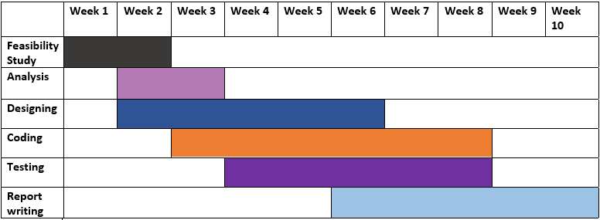
Gantt Chart

Slide 8
Future Scope
Compounding
-Automatic compound pricing and billing
Medication therapy management
-Collecting patient information
-Patient information analytics
-Developing a patient care plan
-Implementing and evaluating medication therapy

Slide 9
SMS and Notification:
With the use of a pharmacy management system, the pharmacist can schedule text
messages to be sent to patients intimating them before their prescriptions running out.
The patients can then let the pharmacist if they need a refill, simply by responding to the
message. The status updates let the pharmacist keep in touch with the patients, ensuring
patient satisfaction.
E-prescription:
Prescriptions are known to be illegible and this can cause confusion among patients and is also a source of error in dispensing the right medicine. E-prescriptions provide a user-friendly option for the patients and also reduce the risk of errors.
The electronic prescription feature can be used by the pharmacy to manage refills and allows doctors to send the new refills directly into the pharmacy management system, allowing rapid dispensing of the medicines. Apart from this, there will be no confusion in offering the right prescription between the physician and the patient.
E-prescription:
Prescriptions are known to be illegible and this can cause confusion among patients and
is also a source of error in dispensing the right medicine. E-prescriptions provide a user-
friendly option for the patients and also reduce the risk of errors.
The electronic prescription feature can be used by the pharmacy to manage refills and
allows doctors to send the new refills directly into the pharmacy management system,
allowing rapid dispensing of the medicines. Apart from this, there will be no confusion in
offering the right prescription between the physician and the patient.

Slide 10
Features
Multi-Store and Multi-Location Support:
The user can manage stores at multiple locations easily with a pharmacy information management.
Data about stock levels, sales, returns from multiple stores can be viewed in a single software. Overall reports for the entire chain of stores can be generated, giving the user a complete overview of profit, loss, stock levels, etc.

Slide 11
Thank You

